Slide 1
Chapter 2
Programming Logic
By: Er. Amrit Poudel

Slide 2
Contents
Program Development Life Cycle
Program Development Tools
Algorithm
Flowchart
Pseudocode
Flowchart structure
Samples of Flowchart and Algorithm
Class Assignments

Slide 3
2.1. Program Development Life Cycle
A correct program can be written with the proper planning and its implementation.
It is easy to write program for simple problems.
But it is very difficult to develop programs for complex problems.
So, programmers develop the program in a planned manner to master the complexity of the problem.
They follow a series of steps involved in the process of program development collectively known as Program Development Cycle (PDC

Slide 4
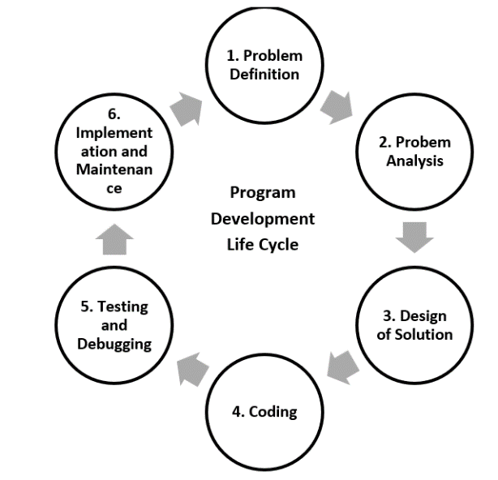
2.1 PDLC
PDLC is a systematic way of developing quality software.
It provides an organized plan for breaking down the task of program development into manageable chunks,
each of which must be successfully completed before moving on to the next phase

Slide 5
1. Problem Definition
This is the first phase where we define the problem statement and decide the boundaries of the problem.
In this phase, we need to understand
what is the problem statement,
what is our requirement and
what is the output of the problem solution.
All these are included in the first phase of program development life cycle

Slide 6
2. Problem Analysis
is the process of eliciting (finding, drawing, extracting), documenting, analyzing, validating and monitoring requirements.
Here, we determine the requirements like variables, functions, etc. to solve the problem.
It means that we gather the required resources to solve the problem, which are defined in the problem definition phase.

Slide 7
3. Design
PDLC is a systematic way of developing quality software.
It provides an organized plan for breaking down the task of program development into manageable chunks,
each of which must be successfully completed before moving on to the next phase

Slide 8
4. Program Coding
Coding can be done in high level language and low-level language.
We write the program to solve the given problem by using the programming languages like C, C++, Java, etc.

Slide 9
5. Testing and Debugging
Debugging and testing are mutual tasks
This is the process of detecting and removing errors in the program so that the programmer produces designed result on all occasion.
Types of error:
Syntax error
Runtime error
Logical error
Late-End error
Debugging is the process of isolating and correcting any type of above-mentioned error.

Slide 10
6. Implementation and Maintenance
The finally developed program is implemented.
However, the software has to go for maintenance due to change in technology, client desire and political environment.
If the user gets any problem or wants any enhancement, then we need to repeat all these phases from the starting, so that the encountered problem is solved or enhancement is added.

Slide 11
7. Documentation
Program documentation starts from the starting of the Software Development Life Cycle (SDLC).
It keeps most of the information of all phases while developing projects.
Documentation is used for future reference for both the original programmer and the beginner.

Slide 12
2.2 Program Development Tools
Tools that are used to provide roadmap for programming.
Algorithm
Flowchart
Pseudocode

Slide 13
1. Algorithm
An algorithm is a finite set of instructions written in a sequence that should be followed to solve a given problem.
The characteristics of algorithm are:
Inputs should be externally supplied for processing.
must produce at least one quantity as output.
Each instruction in algorithm must be clear.
should terminate after a finite number of steps.
Must be effective and implementable.

Slide 14
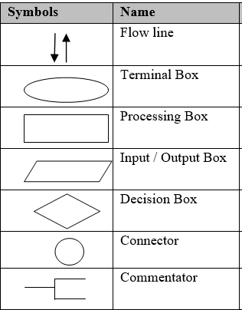
2. Flowchart
is a diagrammatic representation of the procedures for solving a problem.
Simply, it is graphical representation of algorithm.
It consists of a set of symbols for different functions which help a programmer to solve a given problem.

Slide 15
3. Pseudocode
A false coding irrespective to any programming language.
Pseudocode is an informal way of programming description that does not require any strict programming language syntax or underlying technology considerations.
It is used for creating an outline or a rough draft of a program.

Slide 16
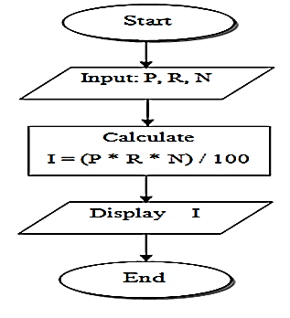
1. Write an algorithm and draw a flowchart to find out the simple interest. Also write the pseudocode.
Algorithm:
Start
Take inputs Principal, Rate and No of years (i.e P, R, N)
Calculate interest (I)
Display Interest
Stop
Flowchart:
Pseudocode:
Declare P, R, N, I
Display “Input principal, rate and no of years”
Input (P, R, N)
I= P*R*N / 100
Display (“Interest is”, I)

Slide 17
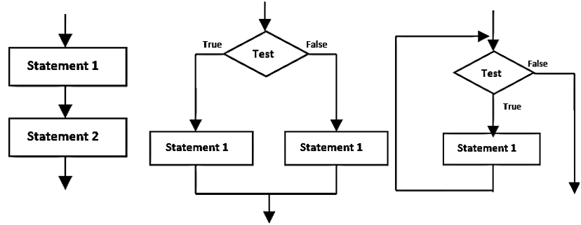
2.4 Flowchart Structures
a) Sequential Structure b) Conditional Structure c) Loop Structure

Slide 18
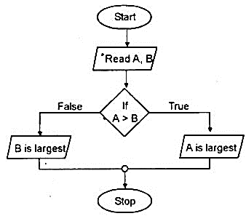
2. Write an algorithm and draw a flowchart to find the largest among two numbers.
Algorithm:
Start
Input A and B
Check: Is A>B?
Yes: Print “A is greatest”
No: Print “B is greatest”
Stop

Slide 19
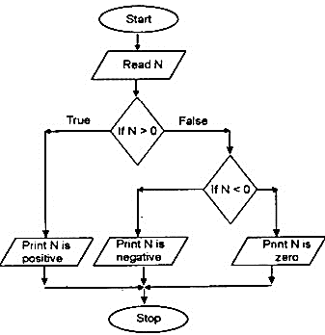
3. Write an algorithm and draw a flowchart to input a number and check if it is positive, negative or zero.
Algorithm:
Start
Input N
Check: Is N>0?
Yes: Print “N is positive” and go to step 5
No: go to step 4
Check: Is N<0?
Yes: Print “N is Negative” and go to step 5
No: Print “N is a Zero” and go to step 5
End

Slide 20
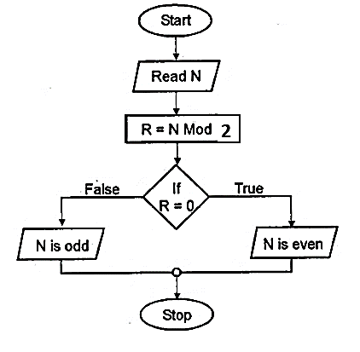
4. Write an algorithm and draw a flowchart to input a number and check if it is odd or even.
Algorithm:
Start
Input N
Check: Is N%2==0?
Yes: Print “EVEN”
No : Print “ODD”
End

Slide 21
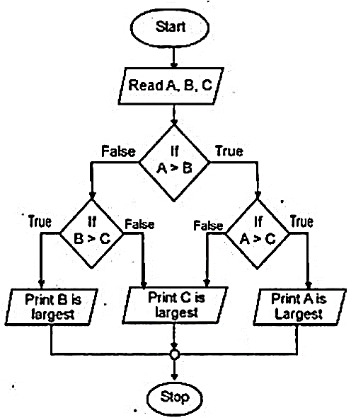
5. Write an algorithm and draw a flowchart to find the largest among three entered numbers.
Algorithm:
Start
Input A,B,C
Check: Is A>B?
Yes: go to step 4
No : go to step 5
Check: Is A>C?
Yes: Print “ A greatest” and goto step 6
No : Print “C greatest” and goto step 6
Check: Is B>C?
Yes: Print “ B greatest” and goto step 6
No : Print “C greatest” and goto step 6
Stop

Slide 22
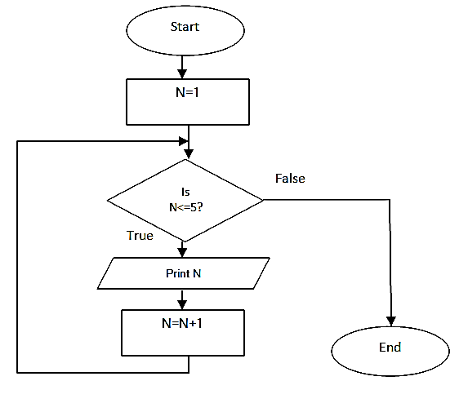
6. Write an algorithm and draw a flowchart to display the number from 1 to 5
Algorithm:
Start
Initialize N=1
Check: Is N<=5?
Yes: go to step 4
No: go to step 6
Print N
N=N+1 and go to step 3
End

Slide 23
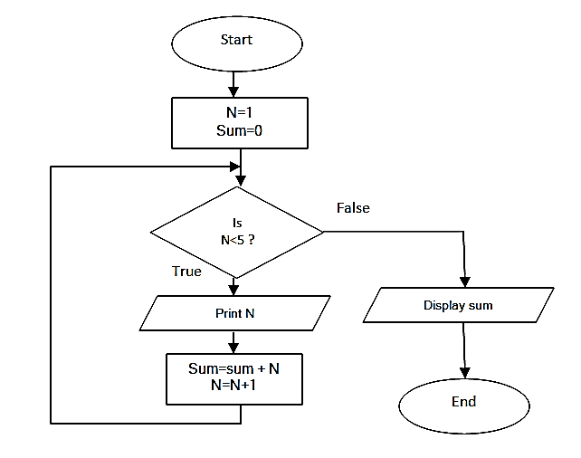
7. Write an algorithm and draw a flowchart to display first four natural numbers, and also their sum.
Algorithm:
Start
Initialize N=1, Sum=0
Check: Is N<5?
Yes: go to step 4
No: go to step 7
Print N
Sum=Sum+N
N=N+1 and go to step 3
Display Sum
End

Slide 24
Assignment
Write an algorithm and draw a flowchart to find the smallest among three entered numbers.
Write an algorithm and draw a flowchart to find the middle among three entered numbers.
Write an algorithm and draw a flowchart to read a positive number (integer) and compute as below:
If the number is even 🡪 half it and print the result.
If the number is odd 🡪 multiply by 3 and add 1 and print the result.
Write an algorithm and draw a flowchart to enter a number and display it in reverse order.
Write an algorithm and draw a flowchart to read the marks of three different subjects and display the total marks. The program should allow entering the marks of other more students if the user presses ‘Y’ key.
Write algorithm and draw a flowchart to print all the prime numbers up to 50.
Write algorithm and draw a flowchart to print factorial of an input number.

Slide 25
End of Chapter

